Slide 1

CV/Resume Writing
Dr. Jukkalkar Syed Imtiaz
Department of English
Shri Shivaji Science & Arts College, Chikhli

Slide 2
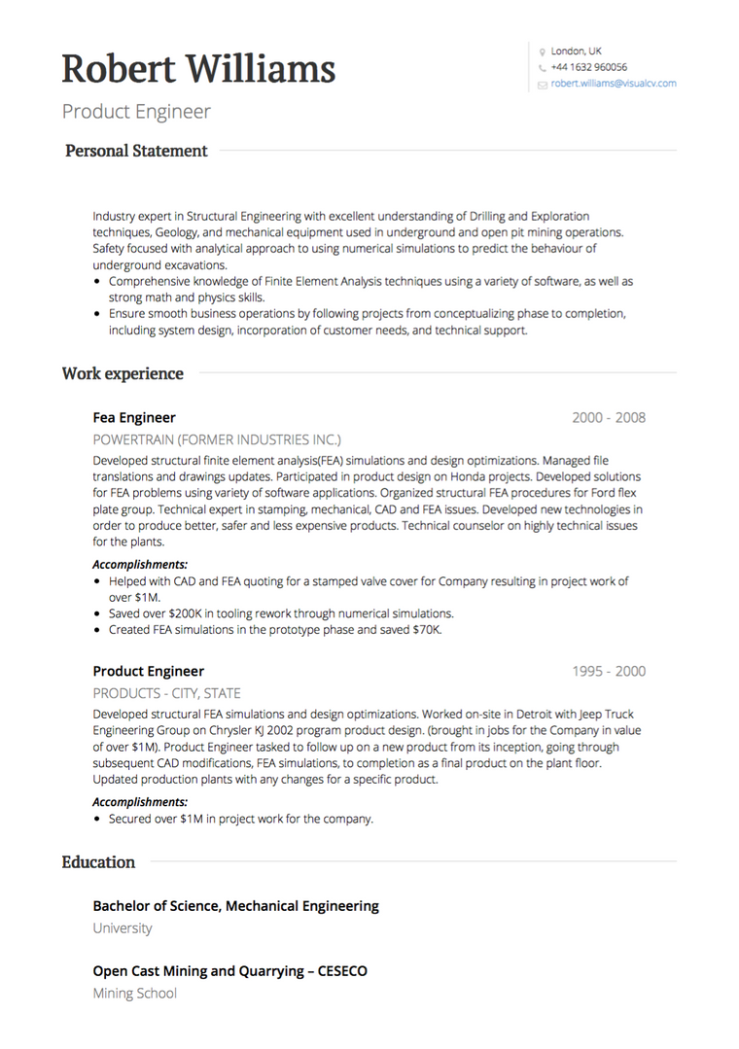
CV / Resume
When it comes to getting a job, the most important document is your C. V.
It is the document responsible to get you a call from the recruitment agency and you can get the job.
You should be careful while drafting your C. V.
google images

Slide 3
The Terms
A CV—short for the Latin phrase “curriculum vitae” meaning “course of life”
It is a detailed document highlighting your professional and academic history.
CVs typically include information like work experience, achievements and awards, scholarships or grants you’ve earned, coursework, research projects and publications of your work.
A CV is typically two or three pages long.

Slide 4
CV vs. Resume
A CV and Resume are similar - they’re both documents that summarize your professional history, education, skills and achievements. They’re also both documents which provide an employer for consideration for an open position.
But -
It is important to note that in the United States and most of Europe, Resumes and CVs are not interchangeable.
A resume is typically a one-page document that provides a concise overview of your previous roles, skills and details about your education. The French word résumé translates to “abstract” or “summary.”
A CV, on the other hand, is typically a longer, more detailed document focused largely on academic coursework and research. CVs are commonly required in the area such as education and academia as well as science and research.
There are a few exceptions, however. In India, South Africa and Australia, the terms CV and resume are interchangeable.

Slide 5
How to write a CV
Writing a CV involves organizing your content into six main segments. They include:
Contact information
Personal statement/profile
Work experience
Education
Skills
Additional sections

Slide 6
1. Contact information
Your contact information is the first element of the CV and serves as the header of the document. It sits at the top so that interviewers can contact you easily. The section should contain only the following elements:
Your full name
Phone number
Job title
Personal email address
Social media handles (optional)
Professional website (optional)
Provide relevant information mentioned in the job description.

Slide 7
2. Personal statement/profile
A personal statement (or CV personal profile) is a concise statement at the beginning of your CV that describes your top skills and the capabilities you will bring to the role. Mention skills, experience and achievements relevant to the job. The personal profile is not mandatory sometimes. If you include it, keep the profile well-written and original. Include positive words such as confident, adaptable, self-motivated and enthusiastic.
Your CV personal profile should:
State who you are
Outline top skills and achievements
Your goals as a potential new employee
The following should not be on your CV personal statement/ Resume Profile :
Why you are applying for the job
Why you left your former employer
Salary requirements
Example: “Self-motivated Commerce Postgraduate with MBA, ready to work hard and adaptable to tough situations. Looking for challenging work and prove as competent manager. With the experience of seven years in TAYA Consultancy, looking for new opportunities ……..

Slide 8
3. Work experience
The work experience section allows the interviewer to see your career path and its relevance to their role. Outline your expertise in reverse-chronological order (most recent first).
Your work experience section can include up to 15 years of experience and state the following information:
Title of the role
Company with city, state
Dates of employment
Three to five bullet points outlining your responsibilities and achievements for each job entry
Research projects
Lab work
Field experience
Volunteer work

Slide 9
Your work experience should not include:
Tables, charts or images
Gaps in employment history
Professional references or supervisors’ names
Short-term employment, unless you have less than two years of work experience
Irrelevant work experience
4. Education
List your education and dates from the most recent to the oldest. You can include your class of degree, dissertation title, coursework, professional qualifications and top academic achievements that relate to the role. If you have more than two years of relevant work experience, you can highlight all of your post-secondary educational qualifications, including the name of the degree and institution.

Slide 10
5. Skills
The skills section describes your accomplishments at previous jobs, like the key skills you developed and experiences that apply to the job.
The skills to include in this section depend on the, position and your personal background.
Research the skills relevant to the industry or position and read the job description carefully.
List only 4 to 8 skills relevant to the role including job-specific skills, soft skills and hard skills. Some examples include:
Foreign languages
Technical skills where relevant
Certified skills
Consider also mentioning your proficiency level such as Basic, Intermediate, Advanced or Expert for every skill on your list.
To further illustrate your skills, list projects where you used your talents and the results.

Slide 11
6. Additional sections (targeted to your audience)
Additional sections targeted toward your audience can include - professional certifications, publications, industry awards and extra training—anything that is relevant to who’s reading your CV. This is a chance to stand out so use the space wisely to showcase your unique achievements.
If you are a student, you can list your volunteer experience and academic achievements. Mention things you can discuss in further detail at the interview.
It may be appropriate to include hobbies and interests on your CV if you have limited work experience. You can mention specific non-work activities in an entry-level CV if they portray you as a good fit for the employer, such as activities that demonstrate your dedication to a cause the employer works with or allow you to practice skills you use on the job.

Slide 12
Tips on writing an effective CV
Use these tips to improve your CV writing and formatting skills.
Fonts and colours: Use legible and standard fonts such as Times New Roman, Georgia, Open Sans and Cambria. Use font sizes 10 to 12 point and be consistent with the style and size throughout your CV. Use larger fonts (size 14 to 16 point) for section headings. This helps to break up your CV while making the sections stand out.
Formatting: Be consistent with the use of italics, bold, bullet lists and font style. Leave enough white space and maintain a minimum of 0.5-inch margins on all sides. This will improve the organization and readability.
Structure: Outline your CV entries in reverse-chronological order so the first thing the recruiter sees are your most recent accomplishments. Use bullet points so recruiters can skim.
Content: Make your writing powerful and concise. Use strong, active verbs throughout. Be sure to edit, revise and proofread your CV before sending.
Verb tense: Use present tense for current jobs and past tense for former jobs. Proofread for consistency.

Slide 13
C. V. / Resume
Personal Details
Name: Sandeep Mahendra Patil
Date of Birth: 13 June,1993
Address: 24, Ram, Nager, Thakur Colony
Amravati - 444 602
Contact No. : 9860426264
E mail id : sandippatil26@gmail.com
Marital Status: Unmarried

Slide 14
Extra-curricular Activities:
I. Was the convenor of the College Commerce Association (2013-14)
2. Won the first Prize in the Unter-collegiate Debate Competition for 2012-2014
3. Won the Second Prize in the Inter-Collegiate Elocution Competition (2013-14)
4. Was the Captain of the SGBAU Volleyball team
Strengths: i. Sincere and hard working
ii. Excellent communication skill
iii. Goal oriented young person
Sr. No. | Year | Examination | Division | Institution/University
1. | 2009 | SSC | Ist | Adarsh High School, Buldana
2. | 2011 | HSSC | 1st | M. G. Junior College, Khamgaon
3. | 2014 | B. Com. | 1st | Jijamata Mahavidhyalaya, Buldana/ SGB Amravati University, Amravati

Slide 15
References:
Capt. Dr. Prashant Kothe,
Principal, Jijamata, Mahavidhyalaya, Buldana
Dr. Omraj S. Deshmukh,
Principal Shri Shivaji Science & Arts College, Chikhli
A reference is someone who your future employer will contact to verify your credentials. (the ability and experience which make you suitable for the job) . A positive recommendation by your references together with your performance in the interview will actually help you in getting hired for the job.

Slide 16
Example - Resume
Rakesh Dattatray Jadhao
1. Profile :
I am hard working responsible individual, who has the aptitude to succeed in any challenging professional environment. I currently look to extend my career to new horizons. A quick learner with strong work ethics, I constantly strive to achieve meritorious standards of work in my field of expertise. Whilst being self motivated, I thrive when working as a part of, or heading a dedicated team. In appointment, I prove a resourceful, reliable honest and committed professional.

Slide 17
2. Skills:
1. Excellent communicator with good interpersonal skills
2. Accomplished in project management, with particular expertise in project analysis, design and implementation
3. Sound business analysis skill
4. The ability to work in a team and independently.
5. Motivated to learn new ideas.

Slide 18
3. Academic History
University of Leicester, USA MBA With Merit | 2010-12
Symbosis, Pune, India MBA Marketing | 2013-14
National Institute of Information Technology, Banglore, India Advanced Diploma in Web Centric Computer Technology | 2014
Calicut University, India B. Sc. Mathematics, Statistics & Computer Science | 2015

Slide 19
4. Career History:
i. Business Analyst 2015 to present
ii. Responsible for designing and implementing
new processes.
iii. Defining scope to projects……..
iv. Perform Gap Analysis, Risk analysis…
v. Analyze and develop Strategic Management
5. Personal Details :
Language Known :
Address for Correspondence
III. e-mail id :
IV. Cell No.

